Slide 1
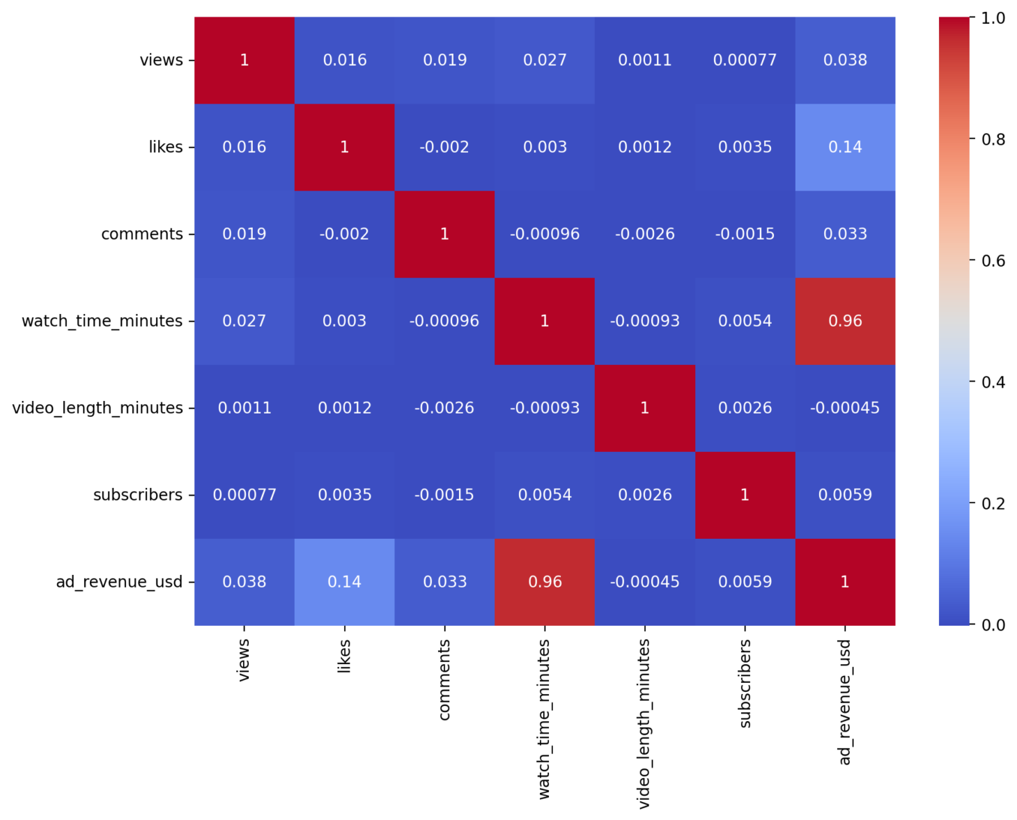
Correlation Heatmap
✨Watch Time strongly drives Revenue.
✨Likes have a weak positive relationships
✨Comments reflects engagement
✨Views alone are not a reliable predictor
✨ Video length and subscribers have minimal impact.
Correlation Heatmap
Correlation Heatmap

Slide 2
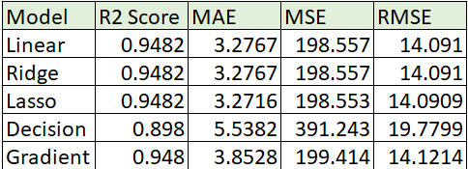
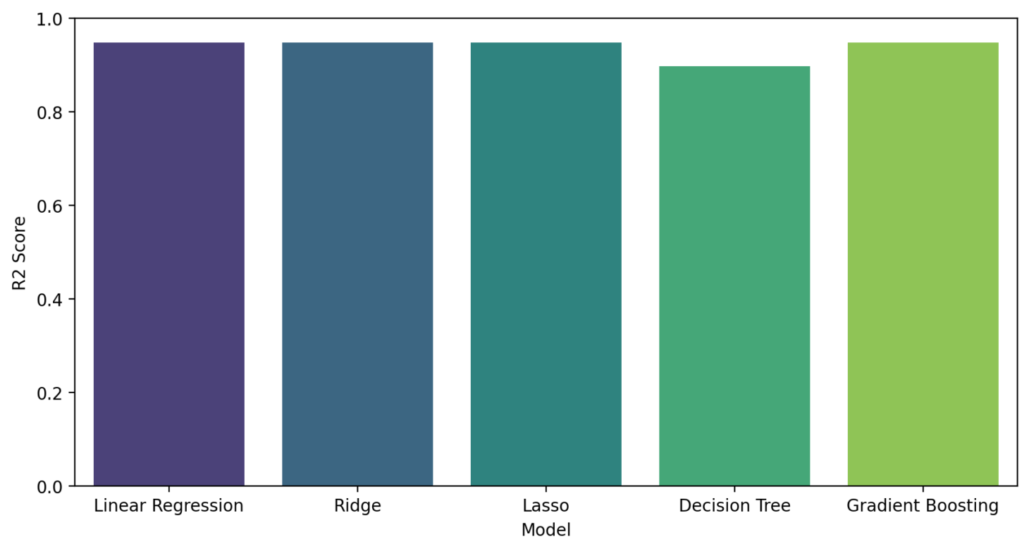
Model Performance Comparison (R2 Score)erf
ance Comparison (R2 Score)
🔎Analysis:
✨ Lasso has the lowest MAE, MSE, and RMSE and a top R² score (0.9482).
✨ Linear Regression and Ridge are almost identical to Lasso but slightly worse in MAE and RMSE.
✨ Decision Tree performs poorly compared to the others.
✨ Gradient Boosting is slightly worse than Lasso in all metrics.
✅ Conclusion: The Lasso regression model is the best model here.
Performance Metrics for Modelso:

Slide 3
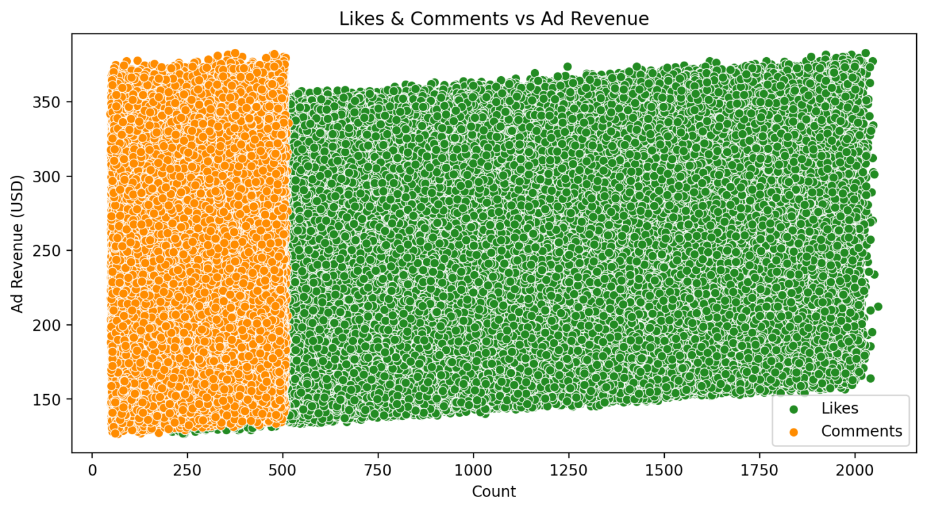
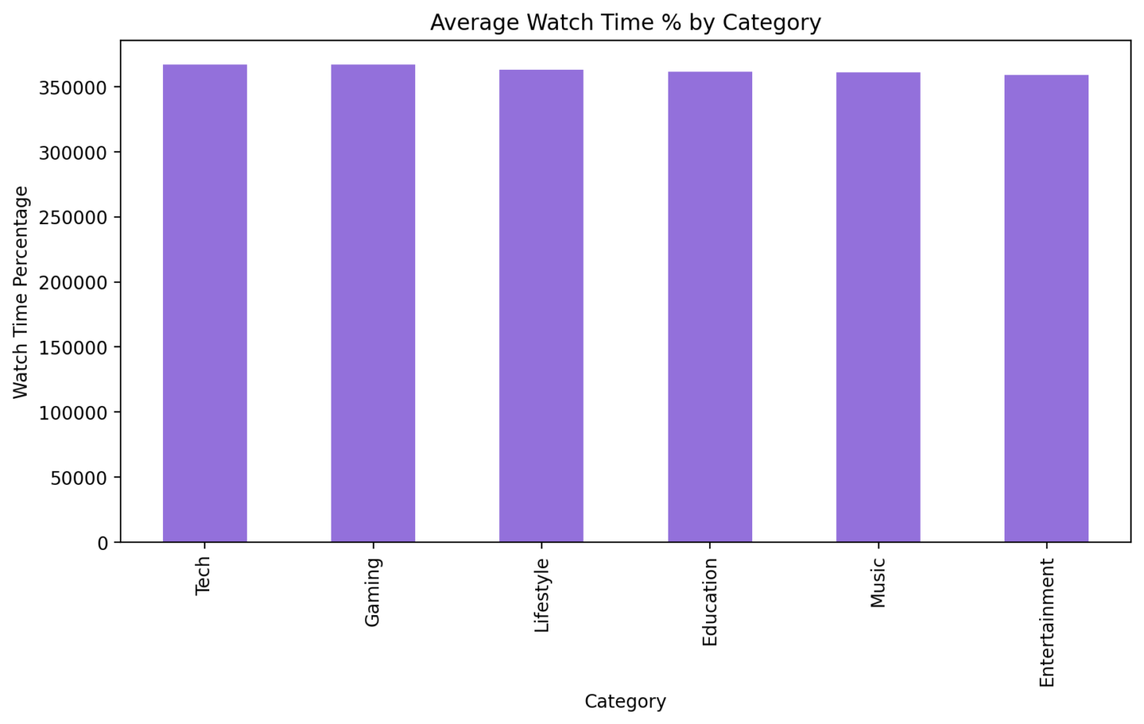
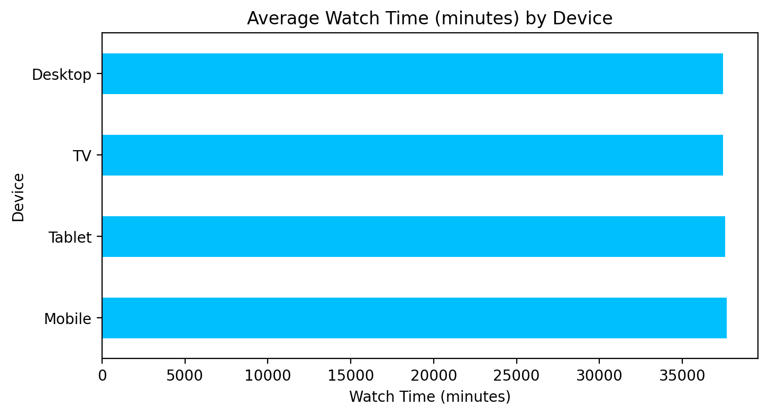
YouTube Content Insights:
✨ The watch time percentage across different categories (Tech, Gaming, Lifestyle, Education, Music, Entertainment) seems quite similar
✨ Mobile usage is higher, YouTube’s mobile ad revenue could be a larger contributor.
✨ Higher engagement likely results in better video placement and thus higher ad revenue.

Slide 4
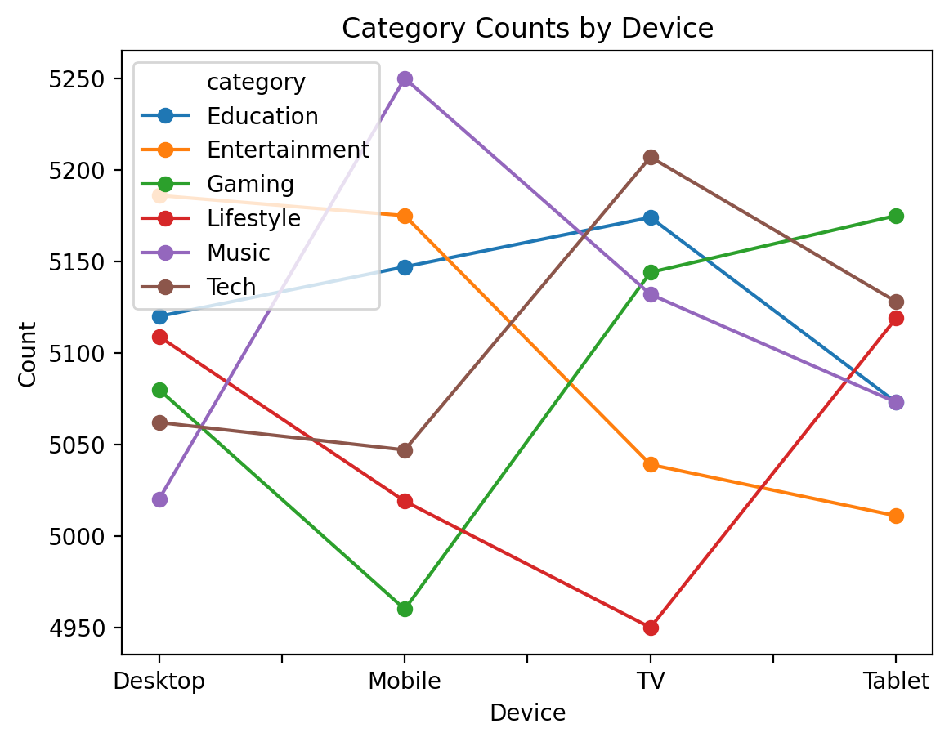
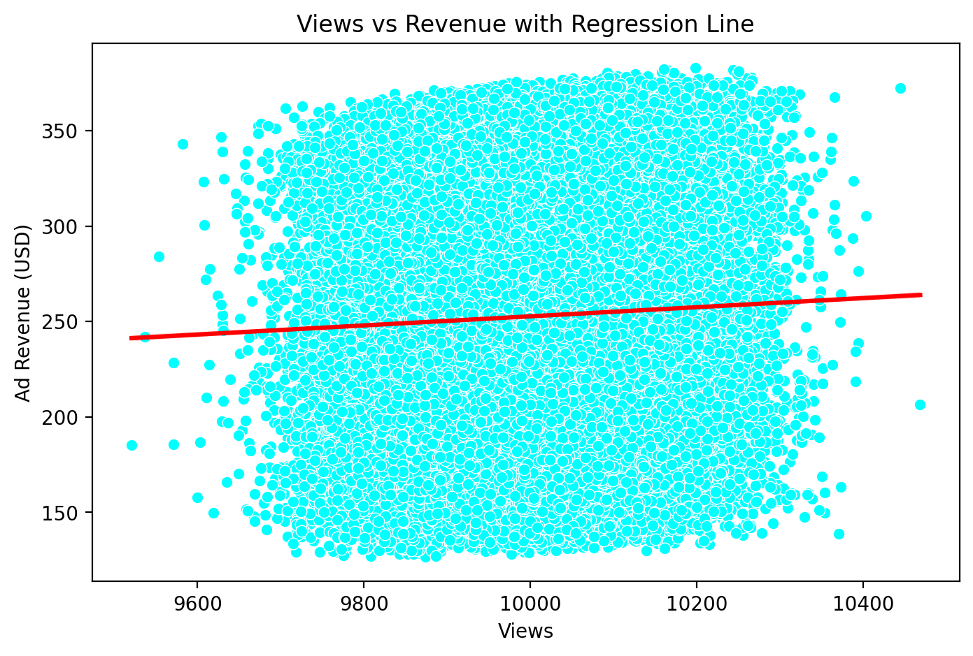
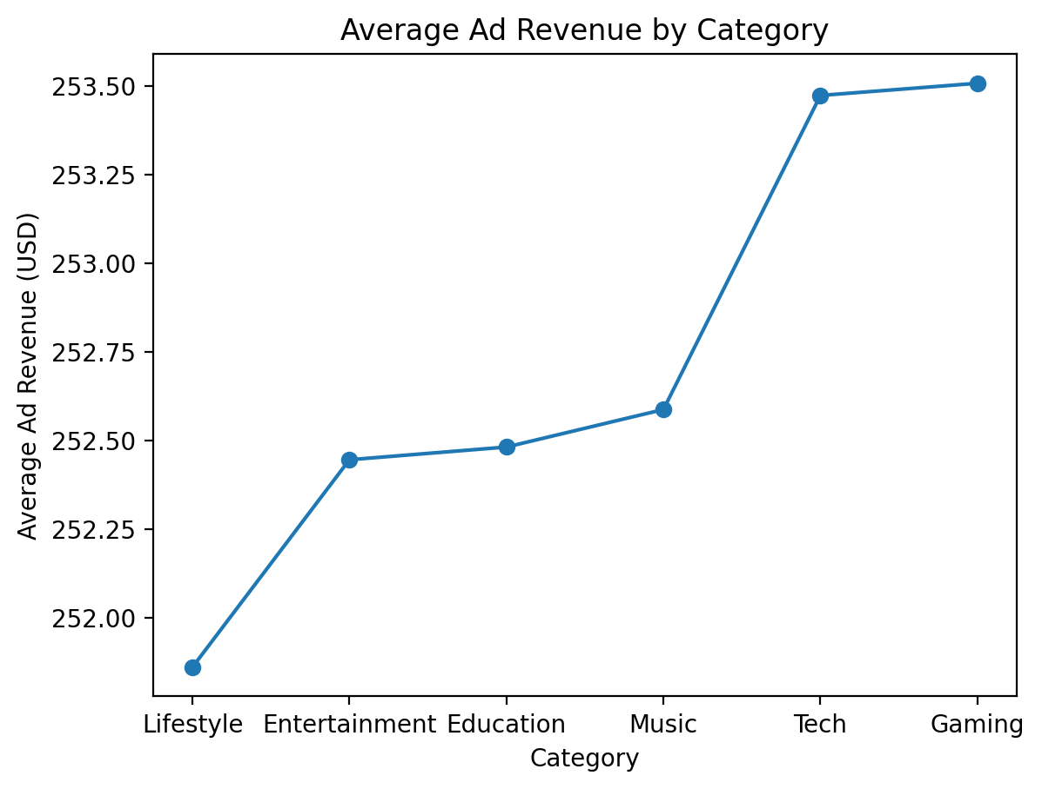
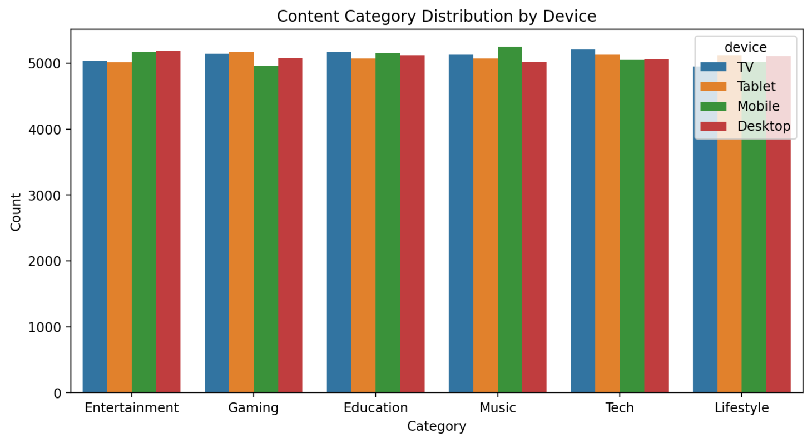
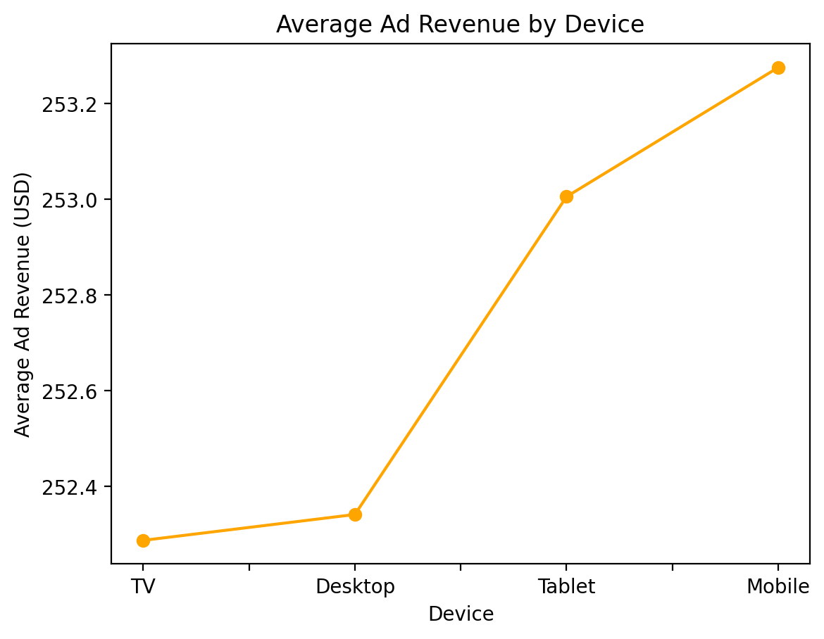
Insights (revenue)
I ✨ Mobile and tablet devices generate significantly higher ad revenue compared to TV and desktop devices.
✨ The "Gaming" and "Tech" categories lead in ad revenue, while categories like "Lifestyle" and "Entertainment" see less revenue.
✨ The distribution of content categories (like entertainment, gaming, education, etc.) is relatively uniform across devices (TV, tablet, mobile, and desktop).
Weak Positive Correlation: The relatively flat red line suggests that views have a very weak or almost negligible impact on ad revenue in this data set.

Slide 5
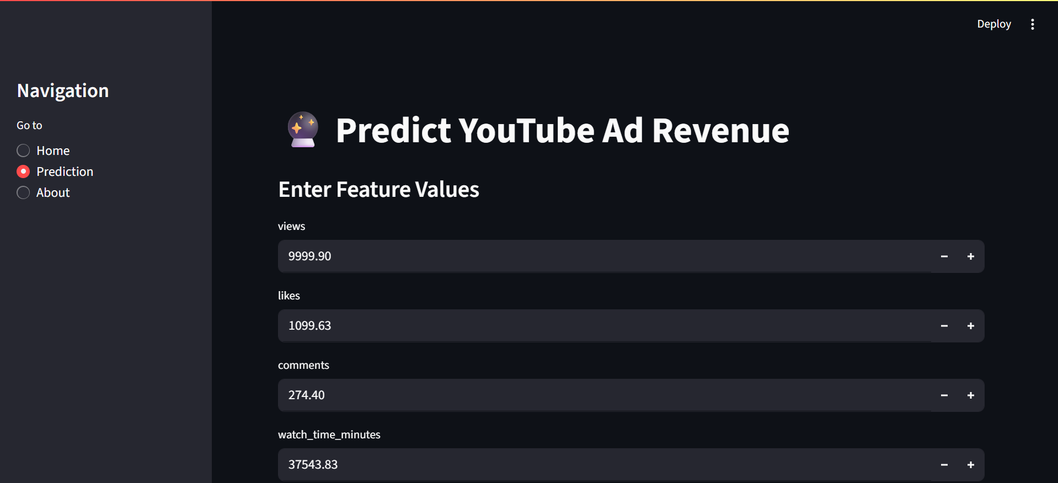
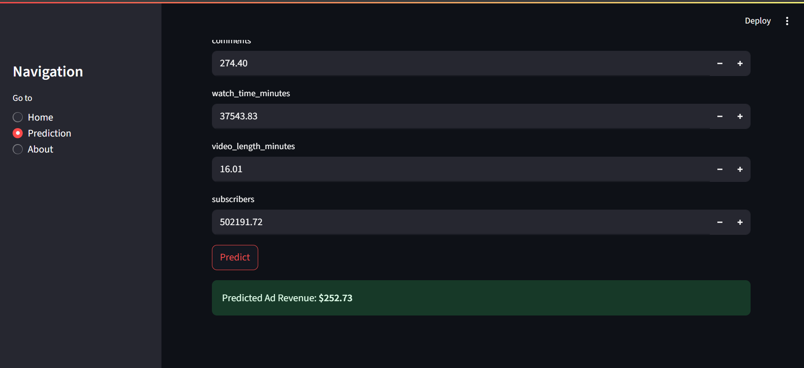
Predict youtube ad revenue based on views, likes, comments, watch_time_minutes, video_length_minutes, subscribers

Slide 6
